Slide 1

Web Summit Rio | 2026

Slide 2

Advertiser - Audience

Slide 3
Media Infrastructure for Cultural & Environmental Economies

Slide 4

Technology

Slide 5

10 ANOS

Slide 6



Slide 7
Broadcasting
Likes
Posts
Shares
Social Platform
Teatro Hoje
News
Live Streams
Entertainment
Audience
Advertising
Development

Slide 8
FLOR3STA S.A.
Rio de Janeiro
Brasil

Slide 9
Built by creators, media operators and cultural networks

Slide 10
Awards
Dia de Congo
O Auto do Rio Piraquê-açu
Proven execution across cultural, media and public initiatives
MICBR 2021
Teatro Hoje no ES

Slide 11
Massive global demand for cultural and environmental content

Slide 12

Information

Slide 13
2019-
Cultural and environmental value remains largely
untapped globally

Slide 14
2019-
Due to fragmented media distribution and lack of infrastructure

Slide 15
PROBLEM
Fragmented media, limited monetization

Slide 16
SOLUTION
Connecting content, media and real-world experiences

Slide 17
SOLUTION
Enabling monetization through media, experiences and data

Slide 18
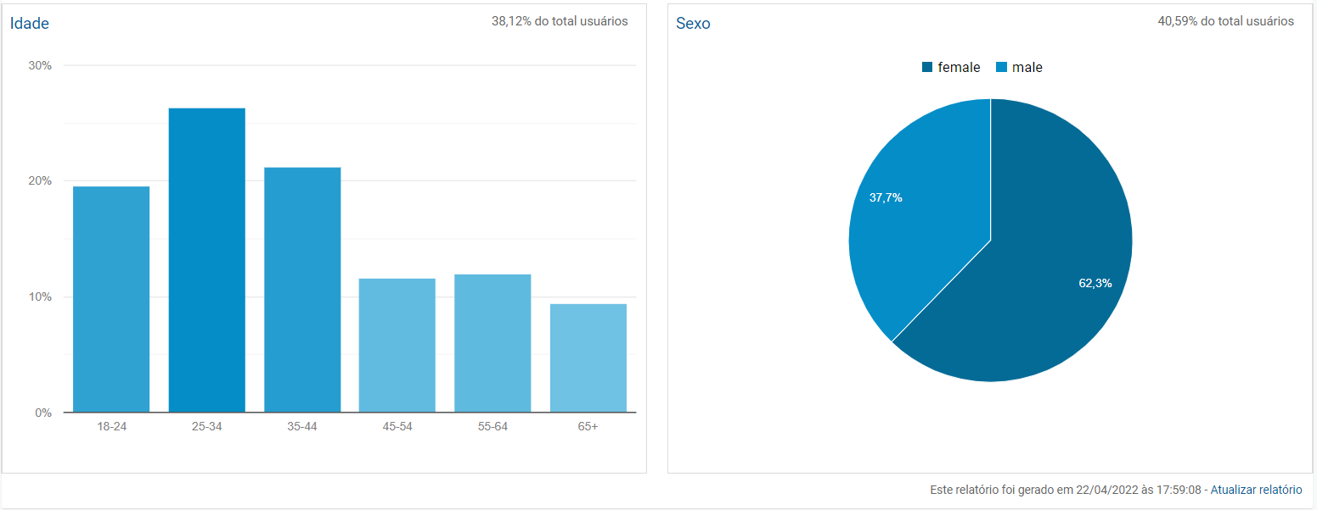

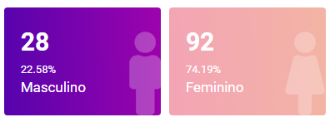
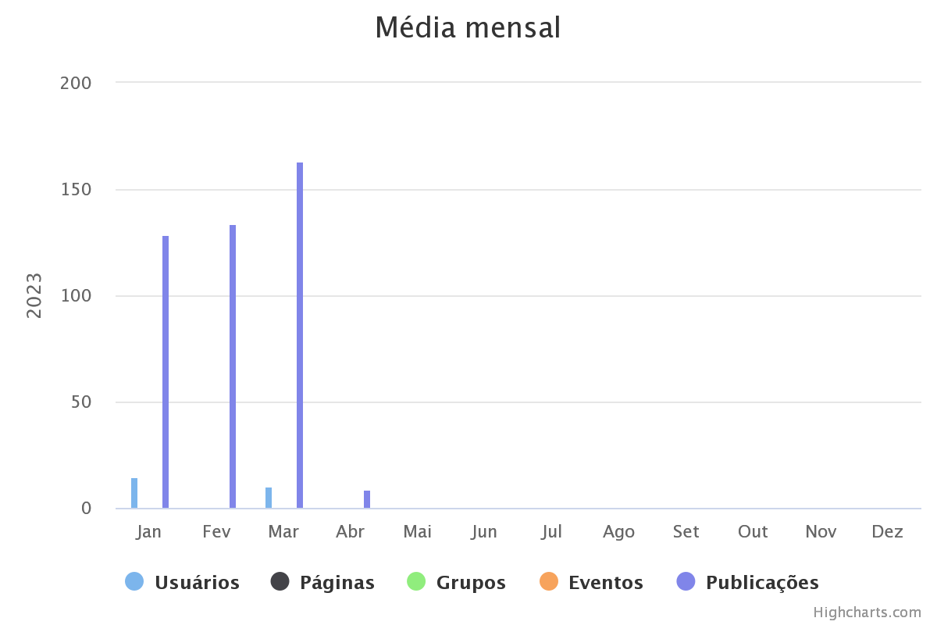
Engajamento
Sexo
METRICS
Early traction:
700+ users | ~7k page views | strong engagement
Relatório gerado em 04.04.2023

Slide 19
Audience profile
Multi-generational audience across Brazil and global digital platforms

Slide 20

Culture

Slide 21
BUSINESS MODEL
Media platform

Slide 22
BUSINESS MODEL
Advertising + Content + Experiences

Slide 23
BUSINESS MODEL
ESG-driven value creation

Slide 24
High-margin media business model

Slide 25
Scalable revenue through advertising
and media inventory

Slide 26
INCOME PROJECTION
Revenue driven by media inventory and advertising demand

Slide 27





Beepe Arte
Beepe Mídias
Beepe T.I.
Grafismos B&P
Built on scalable media and digital infrastructure

Slide 28

Sustainability

Slide 29

ESG governance with environmental and social alignment
Golden share ensures long-term environmental commitment
OSCIP

Slide 30
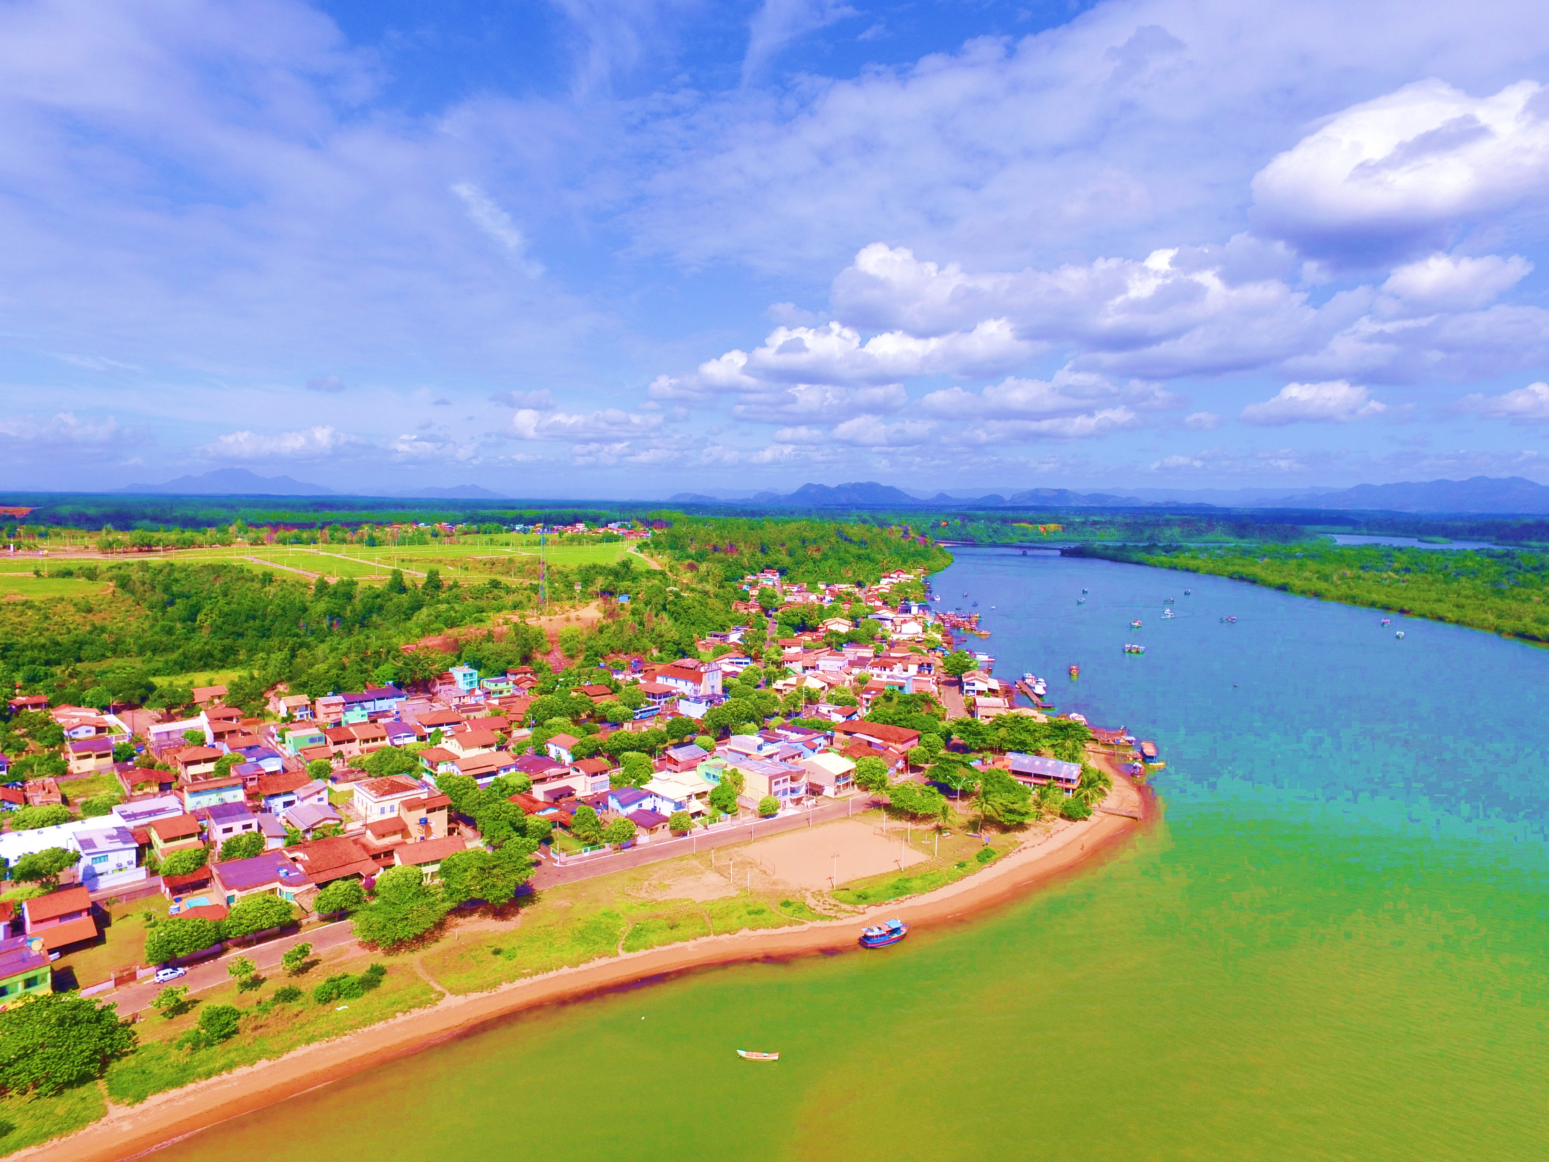
Rio Piraquê-açu

Slide 31


Conhecer Aracruz
Connected to real-world ecosystems and cultural networks

Slide 32


Programming REDESCEC
RADIO

Slide 33
Creators, audiences, advertisers and communities in one platform
Creators
Collaborators
Directors
Spectators
Journalists
Writers
Moderators
Audience
Users
Distributors
Advertisers
Technicians
Influencers

Slide 34

Entertainment

Slide 35
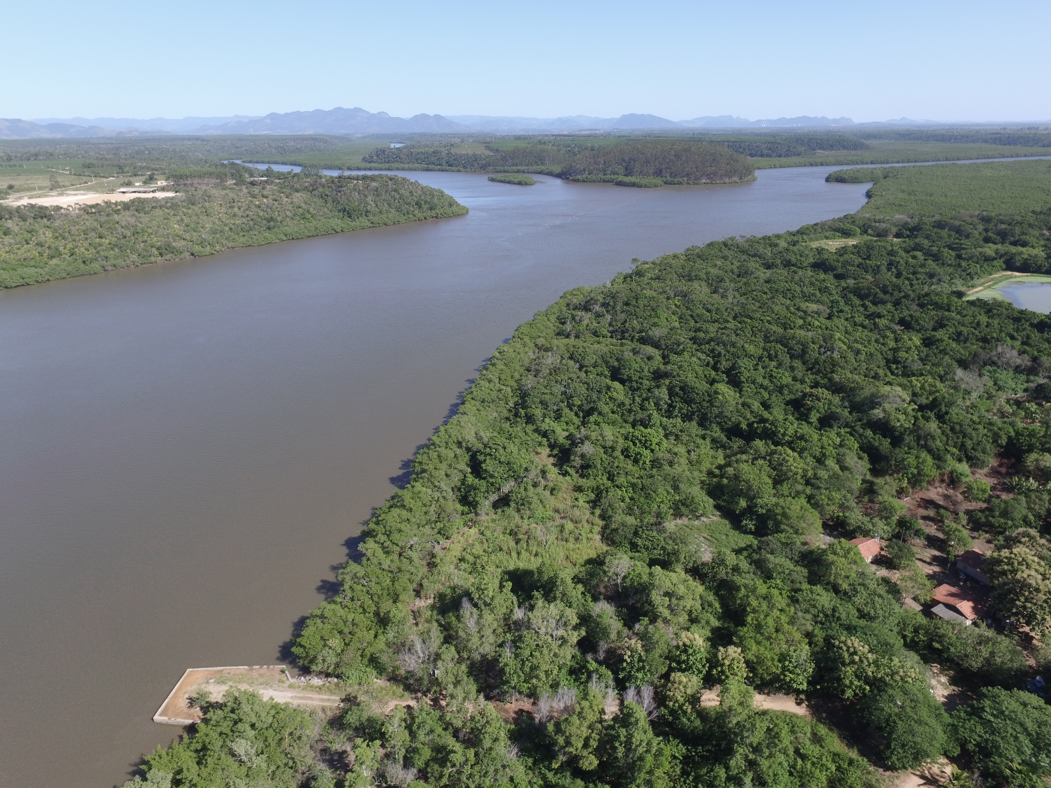
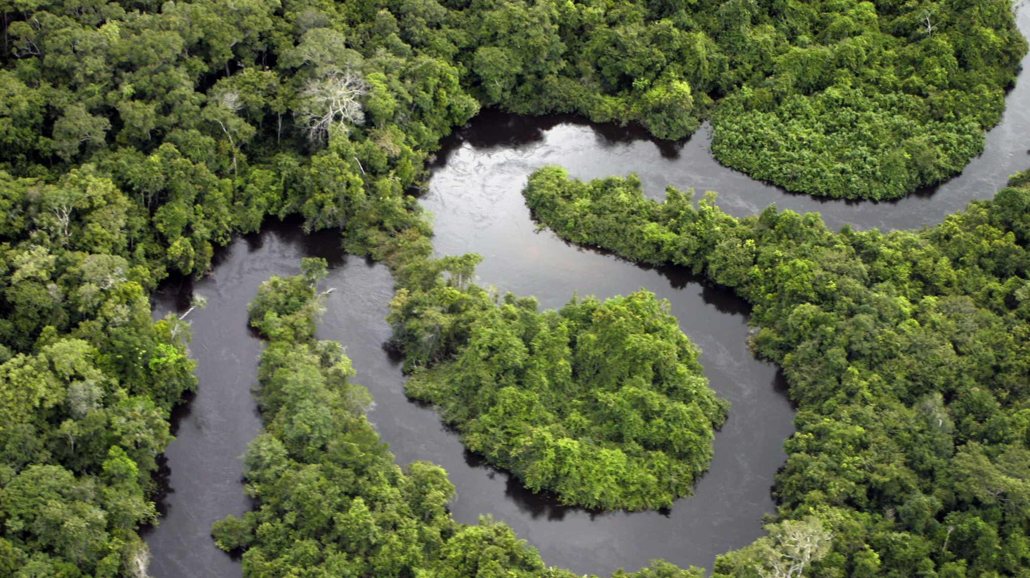
Brasil World

Slide 36
Direct connection between advertisers and engaged audiences

Slide 37

INVESTMENT
Strategic partnerships across media, culture and technology

Slide 38
flor3sta.com

Slide 39
From local ecosystems to scalable global markets

Slide 40


Raising to scale platform development and strategic partnerships

